Slide 1
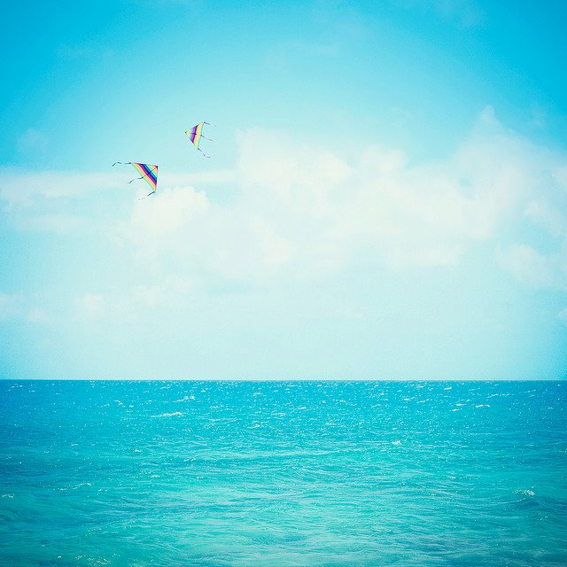
Period 32 Unit 4 My Neighbourhood Lesson 6 Kills 2

Slide 2
Warm up
Find the correct picture with the instruction
Play in 4 teams
First, read the instruction
Second, look at the pictures in 5 senconds
Next, when teacher says “GO”, one student writes the answer on the board
One correct answer will get one star

Slide 3
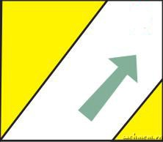
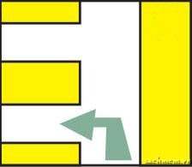
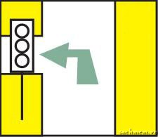
1. Turn left at the traffic lights.
A | B | C

Slide 4
1. Turn left at the traffic lights.
 |  | C

Slide 5
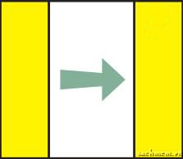
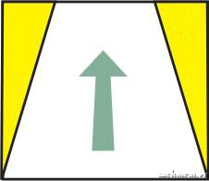
2. Cross the street.
A | B | C

Slide 6
2. Cross the street.
A | B | C

Slide 7
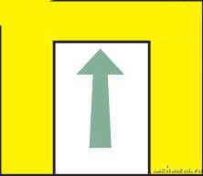
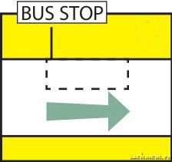
3. Go to the end of the road.
A | B | C

Slide 8
3. Go to the end of the road.
A | B | C

Slide 9
4. Take the first turning on the left.
A | B | C

Slide 10
4. Take the first turning on the left.
A | B | C

Slide 11
5. Go straight on.
A | B | C

Slide 12
5. Go straight on.
A | B | C

Slide 13
Activity1: Listen to the conversation between a stranger and Duy’s dad. Fill in the blanks with the words you hear. Pay attention to the instructions.
A: Excuse me. Where is the supermarket?
B: Go to (1)_____ of this street. It’s on your (2) ____ .
A: And where is the (3) ____ ?
B: It’s in (4) __ . Take the (5) __ , and it’s on your left.

Slide 14
Activity 1: A: Excuse me. Where is the supermarket? B: Go to (1)___________ of this street. It’s on your (2) ___________. A: And where is the (3)___________________ ? B: It’s in (4) ____________ . Take the (5) ___________ , and it’s on your left.
the end
right
lower secondary school
Le Duan street
second right

Slide 15
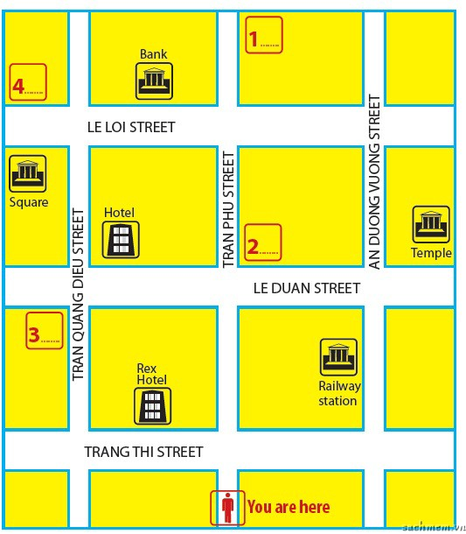
Activity 2: Listen to the conversation again. Choose the correct places from the list below. Write the correct letter A-F on the map.
Supermarket
Restaurant
Secondary school
Art gallery
Pho 99
Quynh cafe

Slide 16
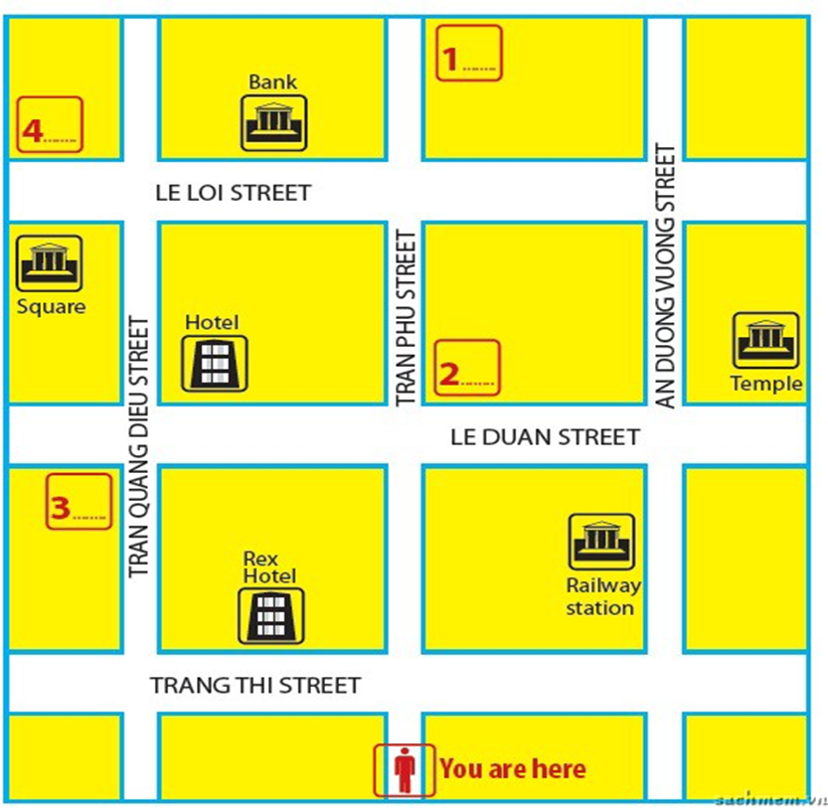
Activity 2:
A
D
C
F

Slide 17
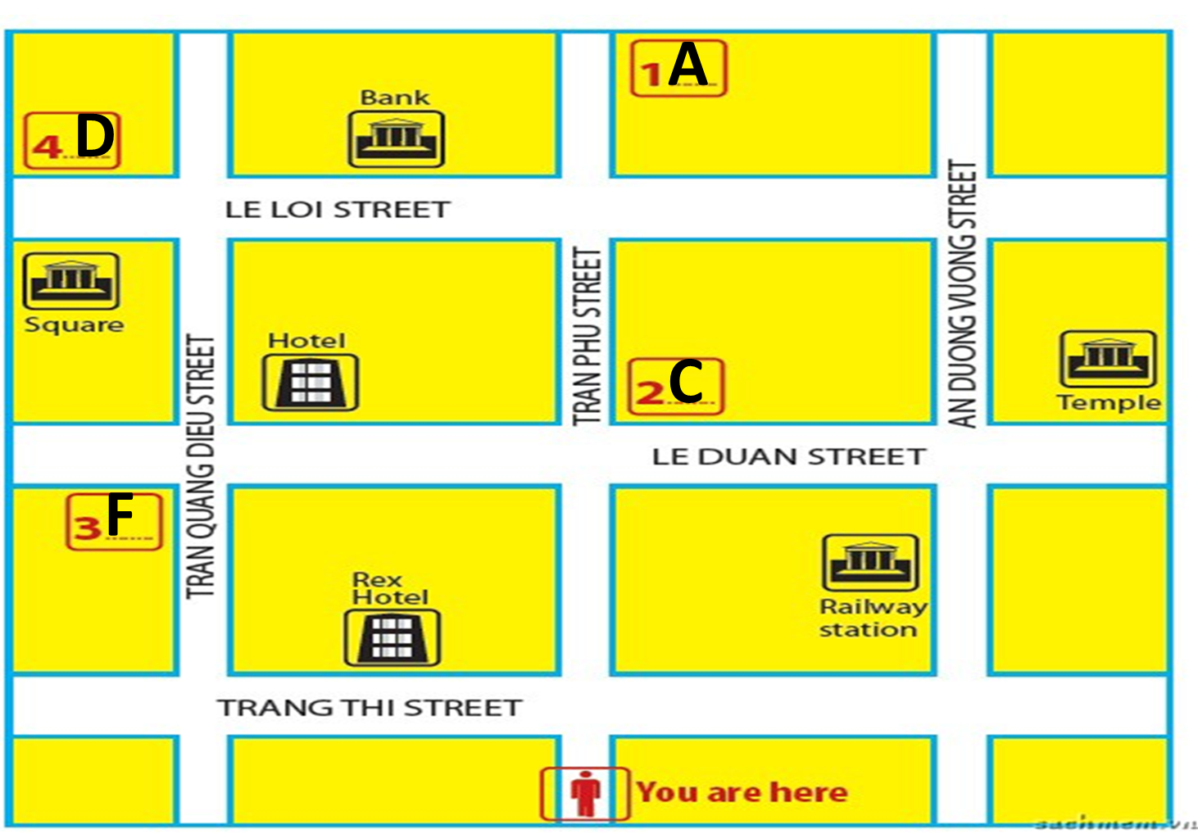
Art gallery
Supermarket
Secondary school
Quynh
cafe

Slide 18
Activity 3: Tick what you like or dislike about a neighbourhood.
 | Like | Don’t like
1. sandy beaches
2. heavy traffic
3. many modern buildings and offices
4. peaceful streets
5. good restaurants and cafés
6. sunny weather
7. busy and crowded streets
8. many shops and markets

Slide 19
Activity 4: Make notes about your neighbourhood. Think about the things you like/dislike it.
Like | Dislike

Slide 20
Activity 5: Write a paragraph about your neighbourhood saying what you like or dislike about living there. Use the information in 4, and Khang’s blog as a model.

Slide 21
Presentation

Slide 22
Homework 1. Finish your paragraph 2. Prepare next lesson: Looking back

